Slide 1
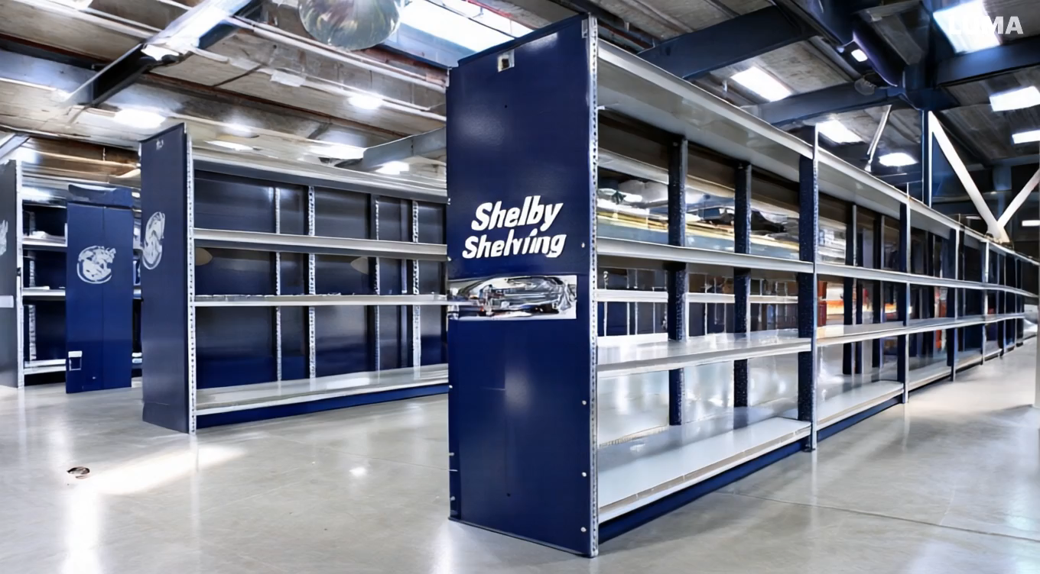
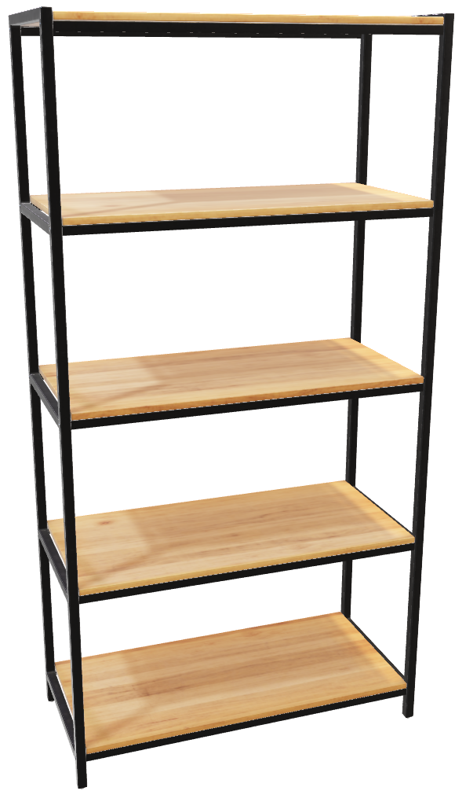
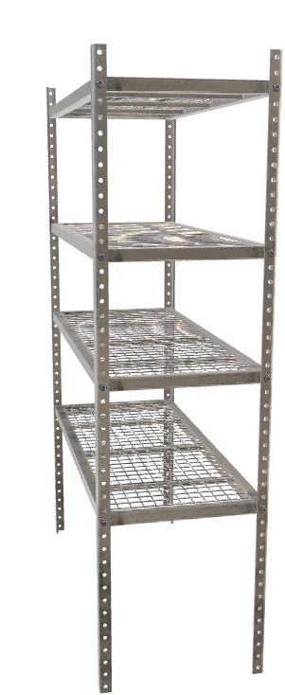
Safaa Almudhffer
Hongxi Zhang
Milan Paremajalu Suresh
Rutuja Patel
Mamidi Manish Reddy

Slide 2
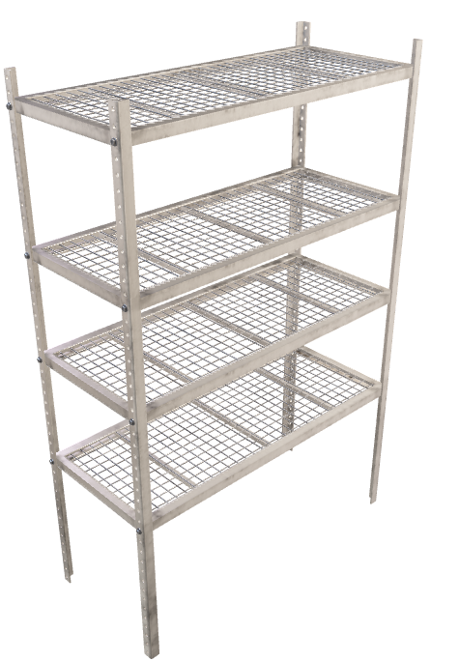
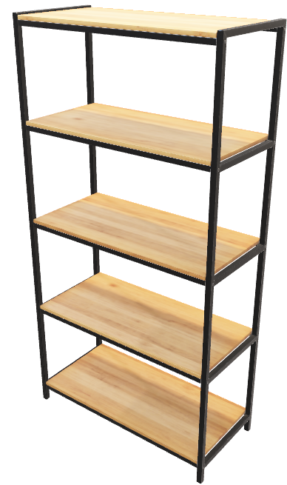
Shelby Shelving
Model LX
Model S
Shelby Shelving manufactures two types of shelves: Model S (standard) and model LX (heavy-duty)
The company faces challenges in maximizing profitability due to production constraints and cost structures
The goal of this project: Use linear programming (LP) to optimize production levels for both models to maximize profit contribution

Slide 3
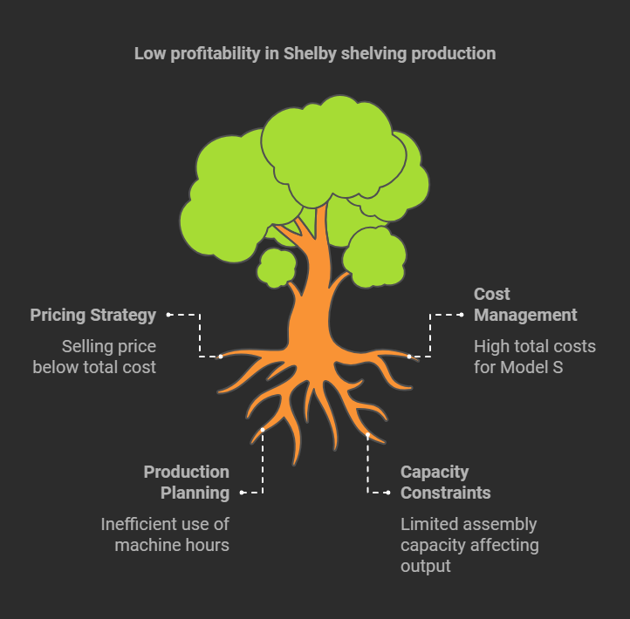
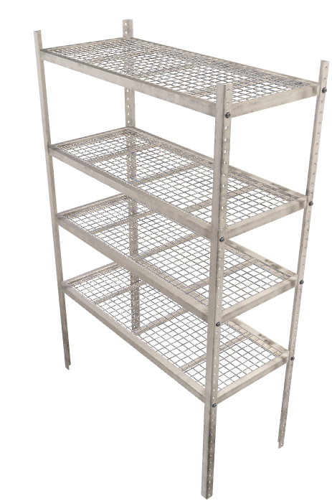
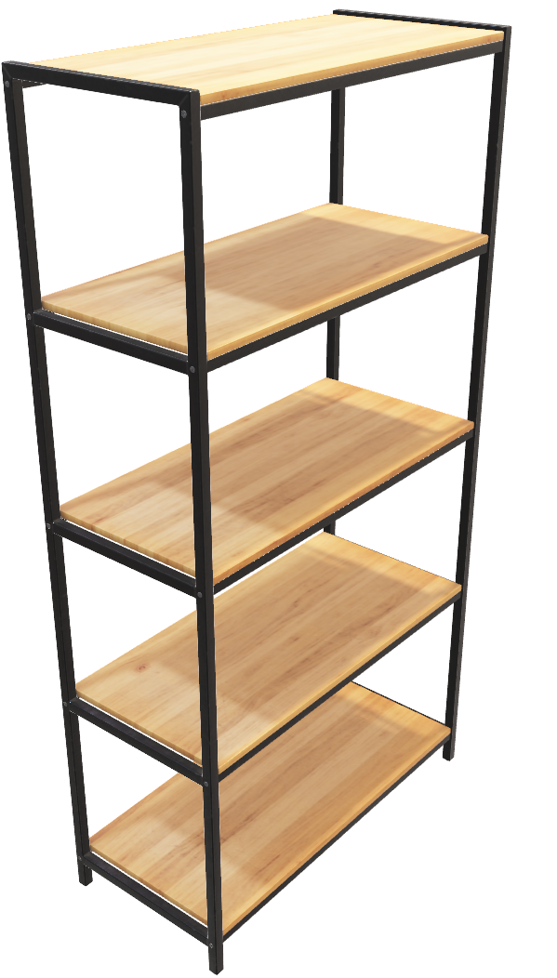
Project Scope & Objectives
Objective
Maximize profit contribution for Shelby shelving
Problem Statement: Current production plan results in low profitability
Model S has a loss per unit: selling price ($1,800) < Total cost ($1,839)
Model LX contributes positively: selling price ($2,100) > Total cost ($2,045)
Scope
Optimize production with machine hour and assembly capacity constraints
Ensure that fixed and variable costs are considered in recommendations

Slide 4
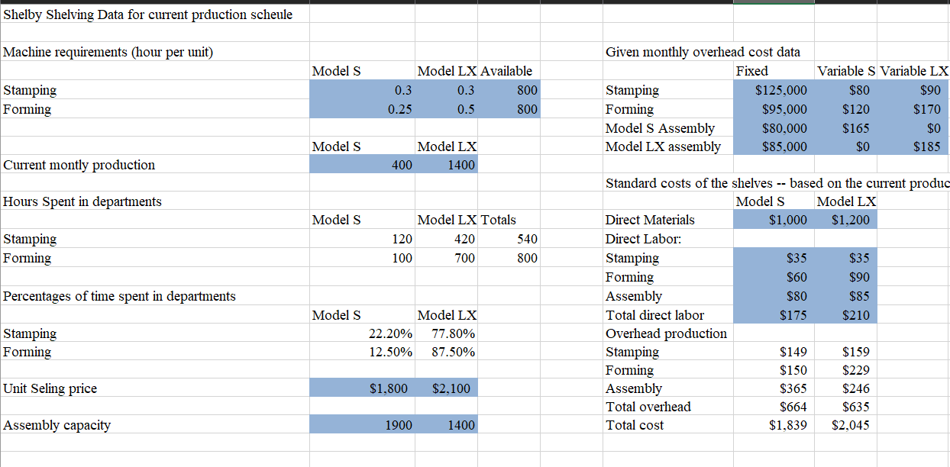
Data and Constraints
Key Data Points
Stamping and forming machine capacities: 800 hours each
Assembly capacity: 1,900 units for Model S, 1,400 units for Model LX
Selling price: $1,800 for Model S, $2,100 for Model LX
Variable total costs: $1,839 for Model S, $2,045 for Model LX
Fixed costs: $385,000
Constraints
Machine hours and assembly capacities
Non-negative constraints on production levels

Slide 5
Data and Constraints
Key Data Points
Stamping and forming machine capacities: 800 hours each
Assembly capacity: 1,900 units for Model S, 1,400 units for Model LX
Selling price: $1,800 for Model S, $2,100 for Model LX
Variable total costs: $1,839 for Model S, $2,045 for Model LX
Fixed costs: $385,000
Constraints
Machine hours and assembly capacities
Non-negative constraints on production levels

Slide 6
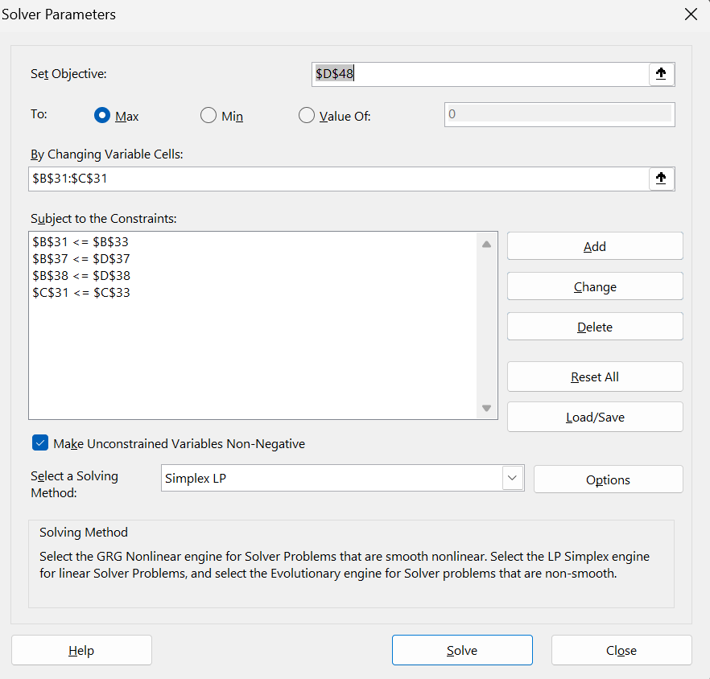
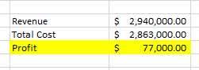
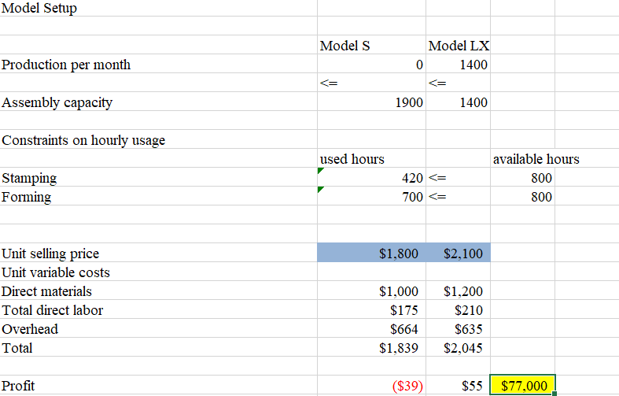
LP Model Setup and Results
LP Model Setup
Objective Function: maximize profit contribution
Decision Variables: production quantities of Model S and Model LX
Constraints
Stamping hours: 0.3 x Model S + 0.3 x Model LX ≤ 800
Forming hours: 0.25 x Model S + 0.5 x Model LX ≤ 800
Assembly capacities: Model S ≤ 1,900 LX ≤ 1,400
Solver Results
Optimal production levels:
Model S: 0 units (because a loss of $39 per unit)
Model LX: 1,400 units (maximum)
Maximum Profit contribution: $77,000

Slide 7
LP Model Setup and Results
LP Model
Input :
i : Index of models (model S & model LX)
j : Index of steps (Stamping & Forging)
H_{ij} : Hours required on each model for j step
S_{i} : Selling price of each model i
A_{i} : Assembly capacity of each model i
T_{i} : Total cost of producing each unit of model i
Decision Variables:
X_{i} : No. of units of model i to produce
Objective:
Max Z = ⅀ ( X_{i} * S_{i}) - T_{i} i ϵ (1,2)
Constraints:
1.) H_{ij} ≤ 800
2.) X₁ ≤ 1900
3.) X₂ ≤ 1400
4.) X_{i} ≥ 0

Slide 8
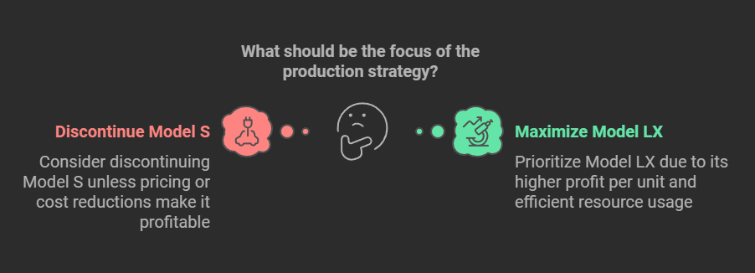
Recommendations to Optimize profitability
Optimal Production Plan
Do not produce any Model S
Maximize production of Model LX to 1,400 units
Strategic Focus
Prioritize Model LX due to its higher profit per unit and efficient resource usage
Cost-Saving opportunities
Consider discontinuing Model S unless pricing or cost reductions make it profitable

Slide 9
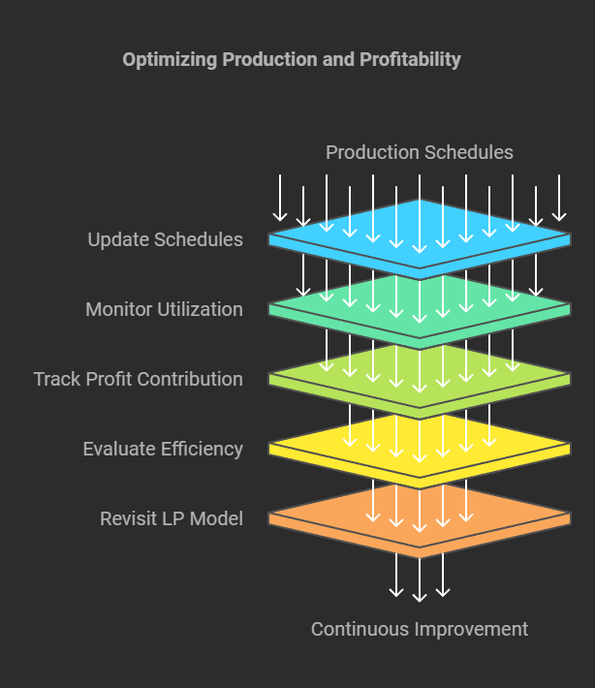
Implementation and Monitoring Plan
Implementation Plan
Update Monthly production schedules to reflect optimal quantities
Monitor stamping, forming and assembly utilization to ensure constraints are met
Monitoring:
Track actual profit contribution against solver projections
Regularly evaluate production efficiency, cost, and market demand
Continuous Improvement
Revisit the LP model periodically to adapt to cost changes or market dynamics
Notes:
We can add visuals here of maybe a timeline or some sort of chart for implementation steps

Slide 10
Conclusion and Next Steps
Summary
The optimized production plan generates a maximum profit contribution of $77,000
Recommendations focus on prioritizing Model LX production and reducing fixed costs or discontinuing the production of Model S as well
Next Steps
Implement the optimal production plan
Conduct follow-up analysis to explore cost-saving measures and strategic pricing for Model S

Slide 11
Thank You

